Slide 1
IoT Temperature Sensor
Internet of Things (IoT) Temperature and Humidity Sensors Communicating over HTTP and MQTT

Slide 2
Goals
Find a use for partially depleted LED Christmas Candle batteries. (60 AA)
Find out if my daughter’s bedroom is really colder than the rest of the house.
Learn MQTT.

Slide 3









Solution
Field Gateway (Raspberry Pi)
Mosquitto
MQTT Broker
MQTT Processor
DB
Web Server
AMQP
Event Hub
HTTP
MQTT
PC
IoT Sensor
ESP8266
HTTP
Visualization
?
HTTP
HTTP
DHT11

Slide 4

Web Server Solution
Field Gateway (Raspberry Pi)
Mosquitto
MQTT Broker
MQTT Processor
DB
Web Server
AMQP
Event Hub
HTTP
MQTT
PC
IoT Sensor
ESP8266
HTTP
Visualization
?
HTTP
HTTP
DHT11

Slide 5
Thing Speak Solution
Field Gateway (Raspberry Pi)
Mosquitto
MQTT Broker
MQTT Processor
DB
Web Server
AMQP
Event Hub
HTTP
MQTT
PC
IoT Sensor
ESP8266
HTTP
Visualization
?
HTTP
HTTP
DHT11

Slide 6
MQTT Solution
Field Gateway (Raspberry Pi)
Mosquitto
MQTT Broker
MQTT Processor
DB
Web Server
AMQP
Event Hub
HTTP
MQTT
PC
IoT Sensor
ESP8266
HTTP
Visualization
?
HTTP
HTTP
DHT11

Slide 7
Event Hub Solution
Field Gateway (Raspberry Pi)
Mosquitto
MQTT Broker
MQTT Processor
DB
Web Server
AMQP
Event Hub
HTTP
MQTT
PC
IoT Sensor
ESP8266
HTTP
Visualization
?
HTTP
HTTP
DHT11

Slide 8
Hardware
ESP8266 – WiFi System on a Chip (SoC)
DHT-11 – Digital Humidity & Temperature Sensor
Raspberry Pi

Slide 9
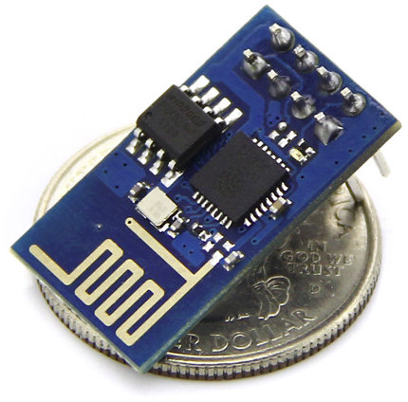
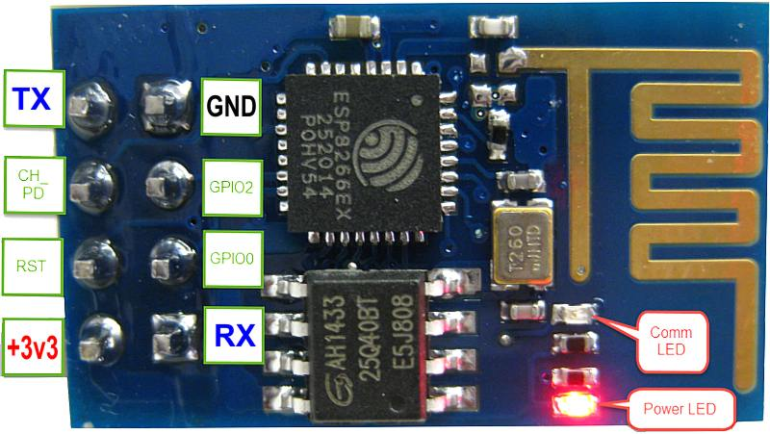
ESP8266
Espressif Systems’ Smart Connectivity Platform (ESCP) of high performance wireless SOCs, for mobile platform designers, provides unsurpassed ability to embed Wi-Fi capabilities within other systems, at the lowest cost with the greatest functionality.
802.11 b/g/n protocol @ 2.4GHz
32bit CPU @ 26MHz to 52MHz w/512KB flash 80KB RAM
Up to 16 GPIO pins. The ESP-01 only exposes 2.

Slide 10
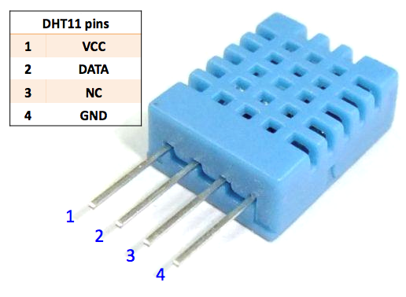
DHT-11
DHT11 digital temperature and humidity sensor is a composite Sensor contains a calibrated digital signal output of the temperature and humidity.
Good for 20-80% humidity readings with 5% accuracy
Good for 0-50°C temperature readings ±2°C accuracy
No more than 1 Hz sampling rate (once every second)

Slide 11
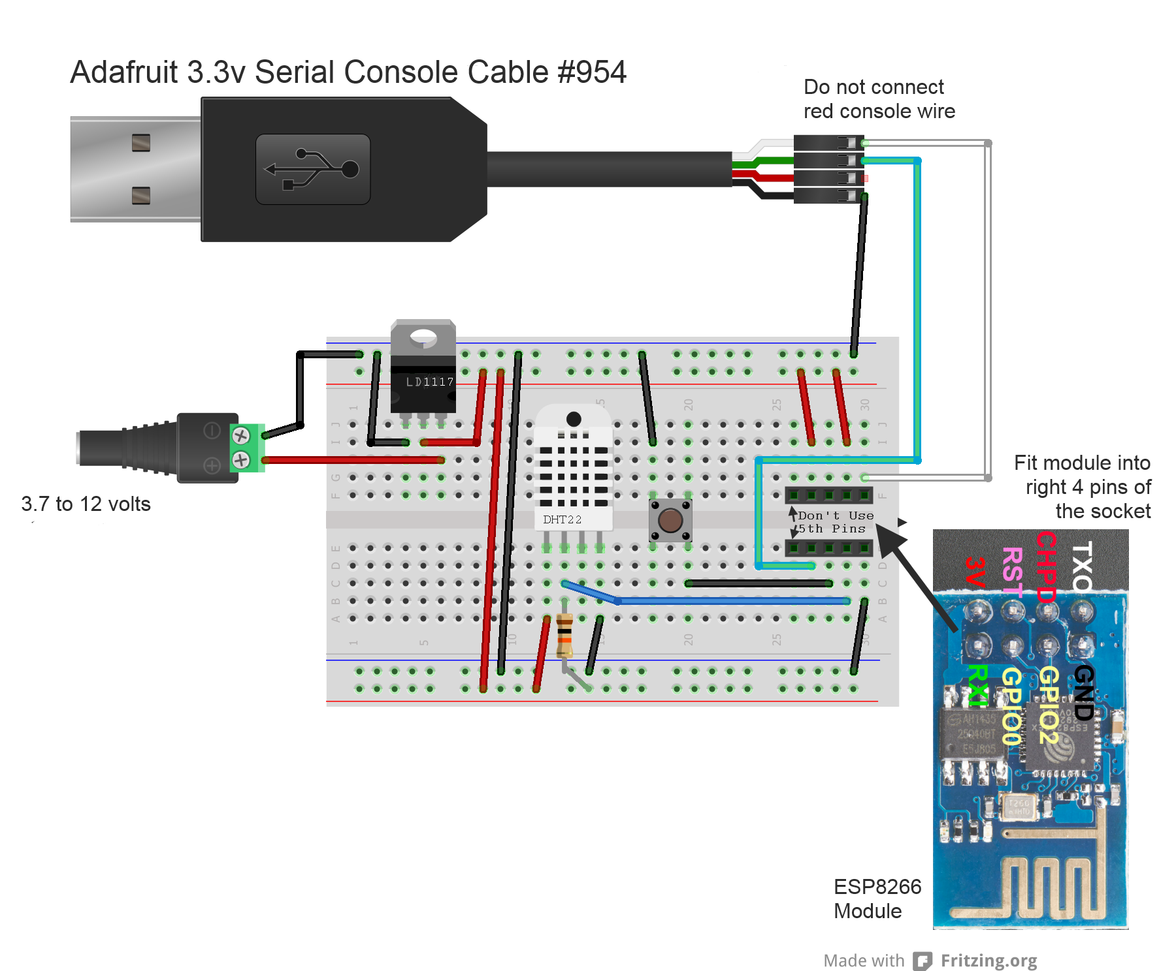
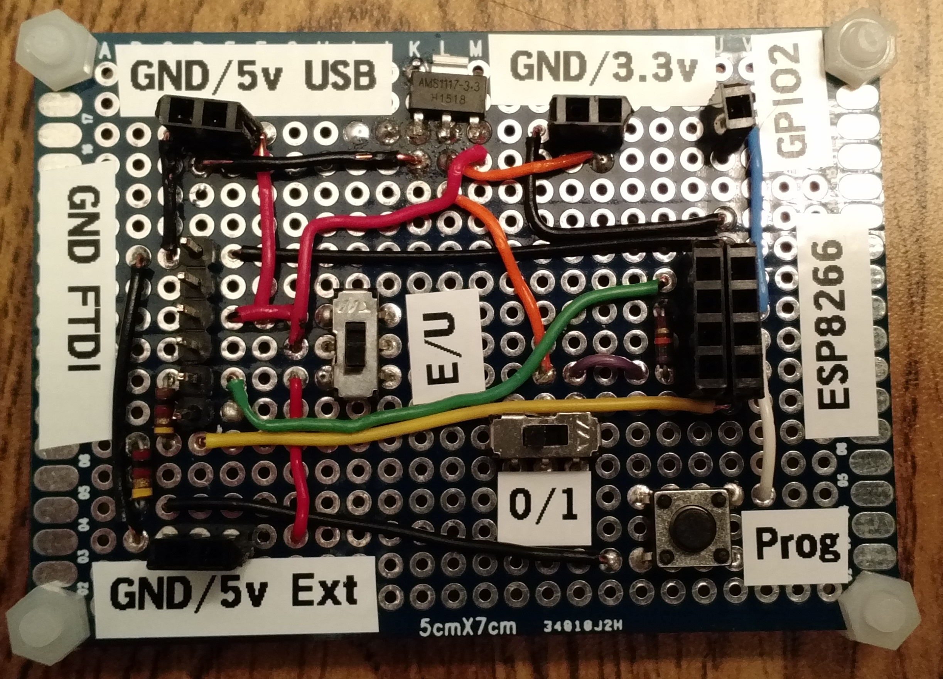
Programming Board Wiring

Slide 12
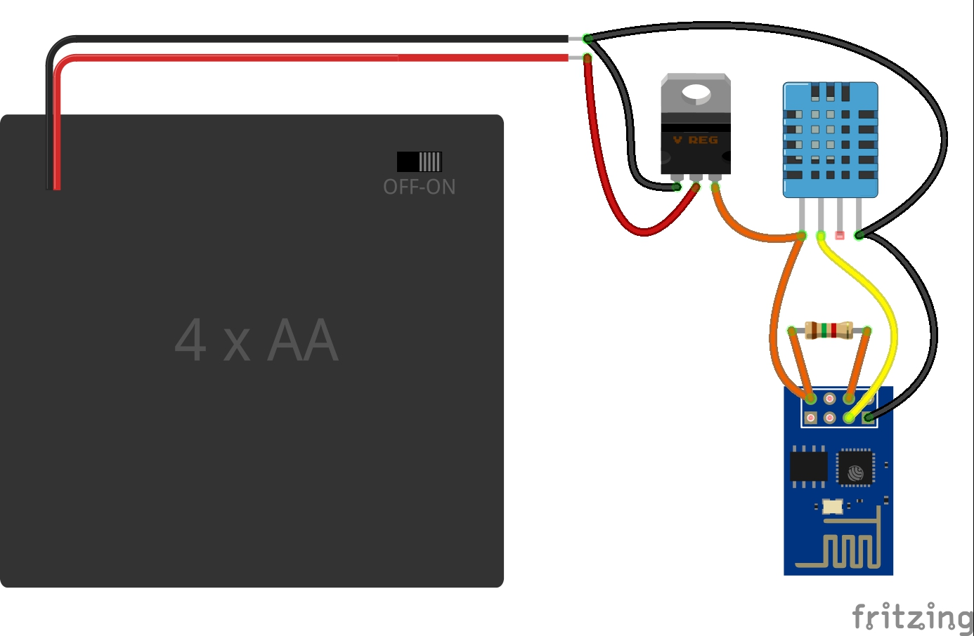
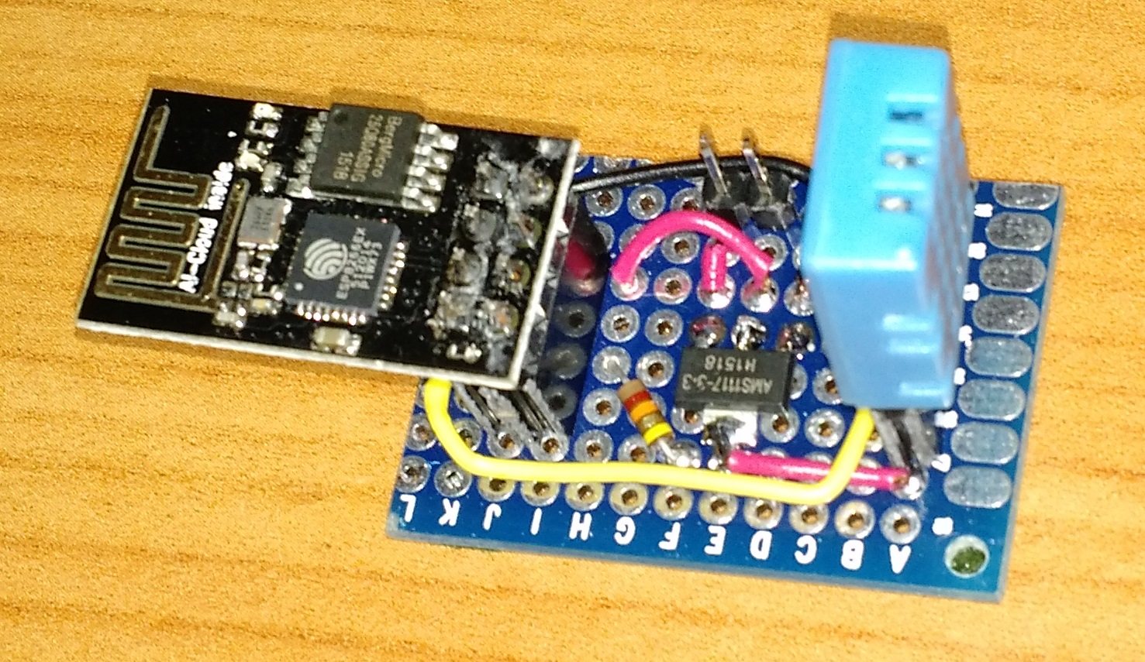
Sensor Wiring

Slide 13
Sensor Costs
Item | Cost
ESP8266 ESP-01 | $6.99
DHT-11 (4 @ $6.99) | $1.75
3.3v Regulator (10 @ $5.35) | $0.54
Circuit Board (10 @ $7.99)/4 | $0.20
Battery Holder (5 @ $5.94) | $1.19
Total | $10.67

Slide 14
Programming ESP8266 Software
Arduino IDE
ESP8266 Module for Arduino IDE
Web Server (built in)
PubSubClient
ArduinoJSON
DHT library from Adafruit
GitHub
https://github.com/greggubben/esp8266_iot_temp

Slide 15
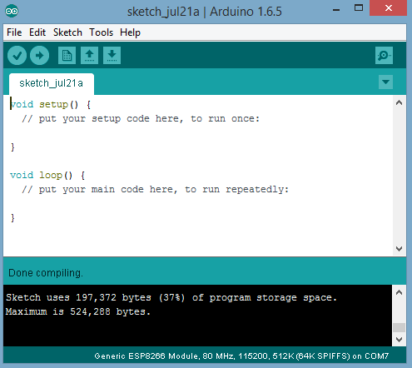
Arduino IDE Demo
Show Code
Programming ESP8266 Demo
Serial Monitor Demo

Slide 16
Thing Speak Demo
Sensor Web Server
http://192.168.?.?
Thing Speak
http://thingspeak.com/users/greggubben

Slide 17
Programming Field Gateway (Raspberry Pi)
Mosquitto MQTT Broker and Client
Python
Paho MQTT Client
TinyDB (JSON Database library)
Azure library
Apache2 Web Server

Slide 18
MqTT Demo
Queue
mosquitto_sub –t “#” –v
Listener
mqtt_listener.py
Web Site
http://192.168.?.?
Notes:
Triple Screen
Mosquitto_sub
Mqtt_listener
Serial Monitor

Slide 19
Event Hub Demo

